Slide 1
ECE532
WiFi Assisted Autonomous Parallel Parking
Group 2
Cheng Lin He
Qiu Yuan Chen
Jing Xie

Slide 2
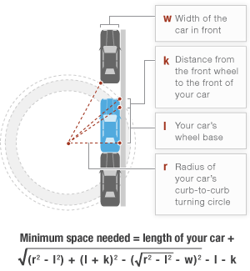
Project Goals
Goal
Reproduce autonomous parking system on a RC car that can autonomously perform a parallel parking into a designated spot.

Slide 3
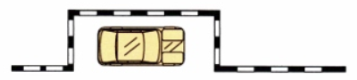
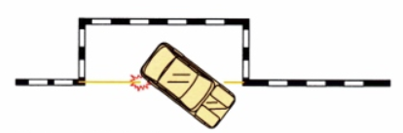
Project Requirements
Requirement
Can detect parking location with suitable geometry
Can query the availability of a parking location over internet
Can parallel park into suitable parking location
Must stop the car to prevent potential collision

Slide 4
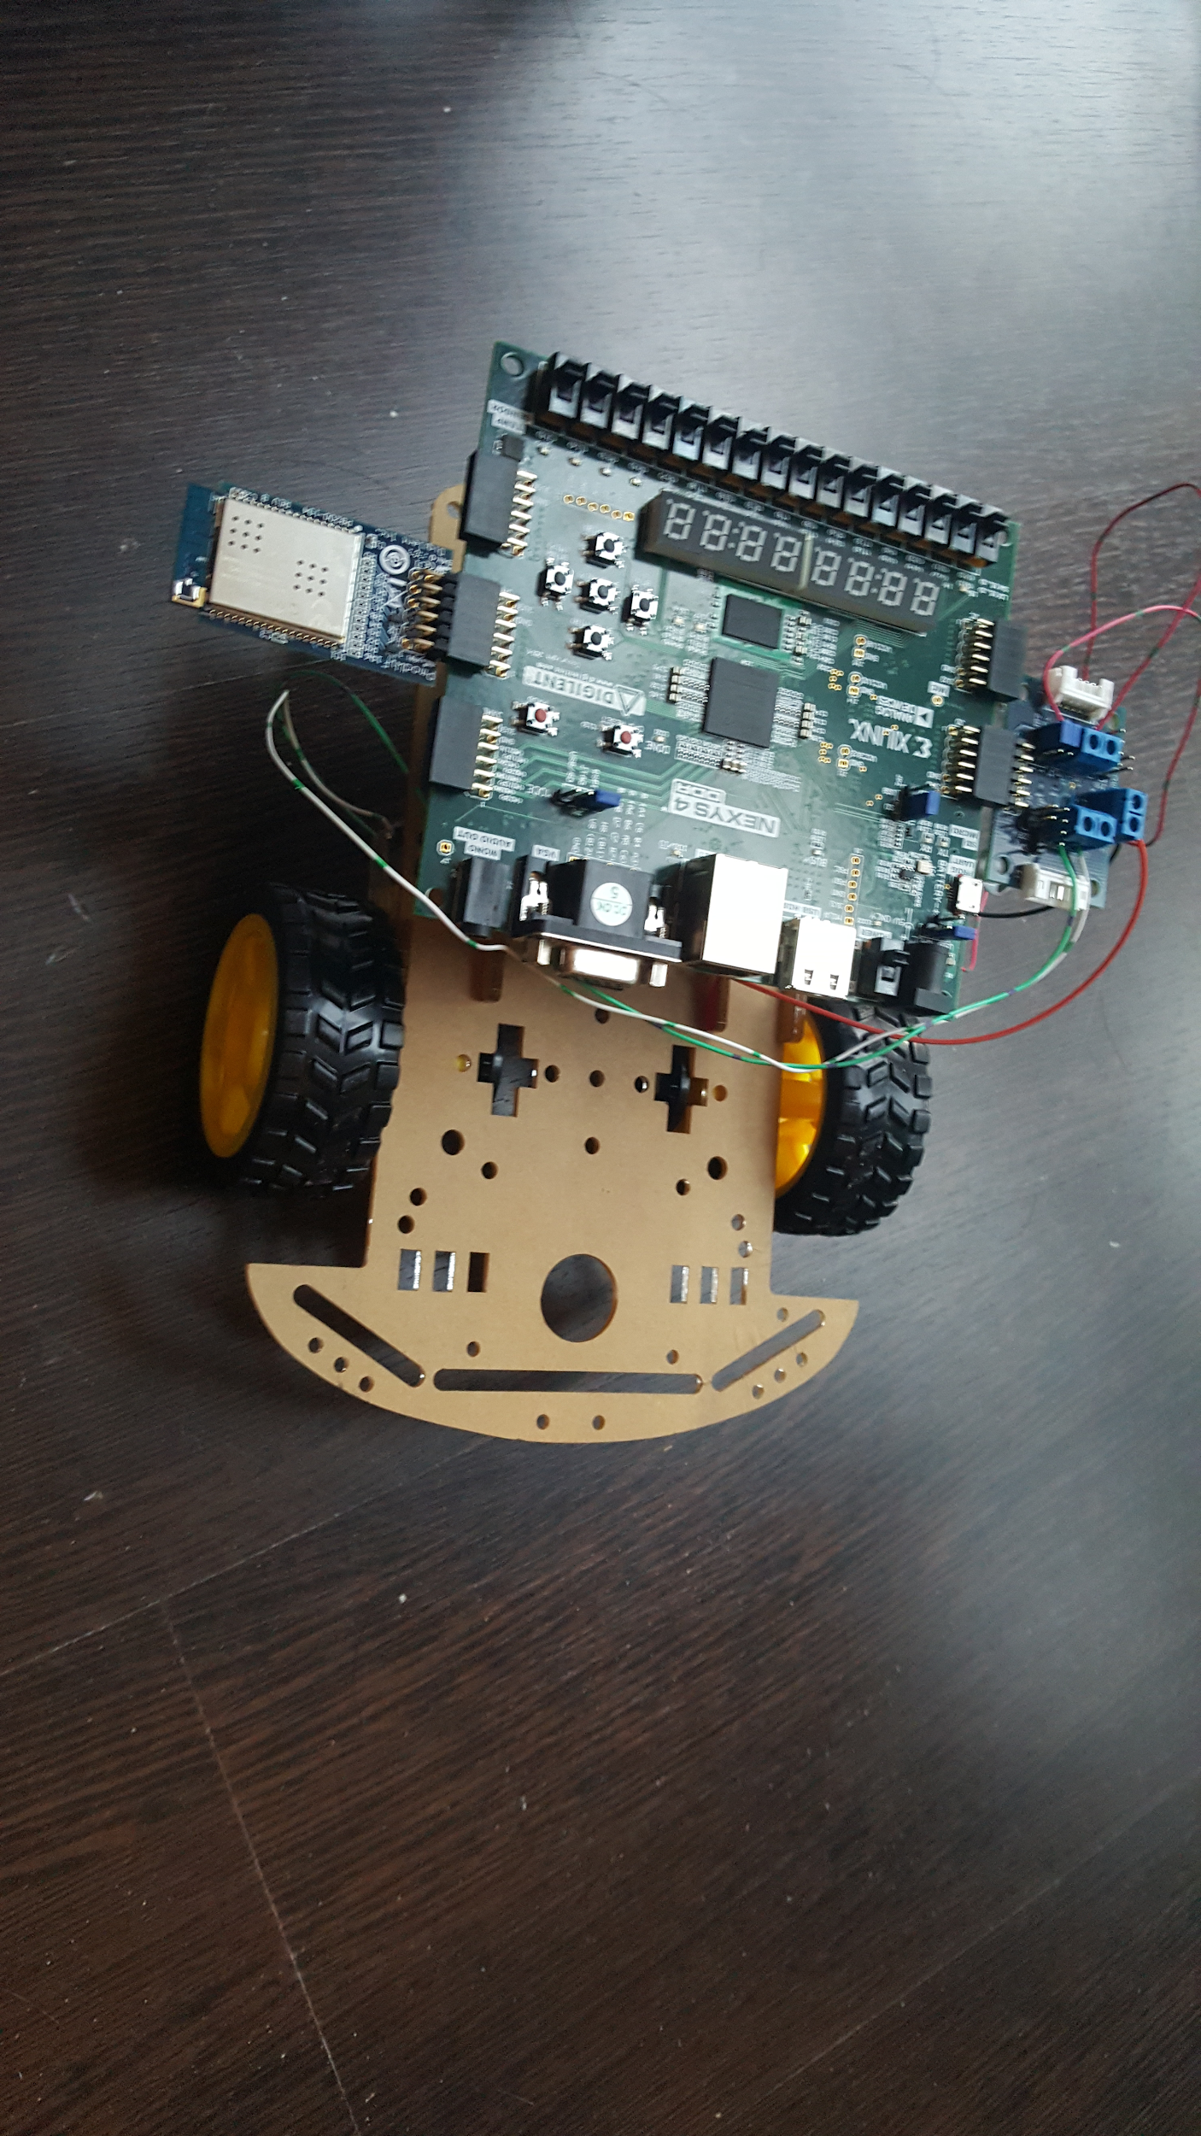
Status Update
Achieved all goals
Switch query for parking spot
Parallel parking between two lines
Parallel parking with obstacles
Determine if enough space for parking

Slide 5
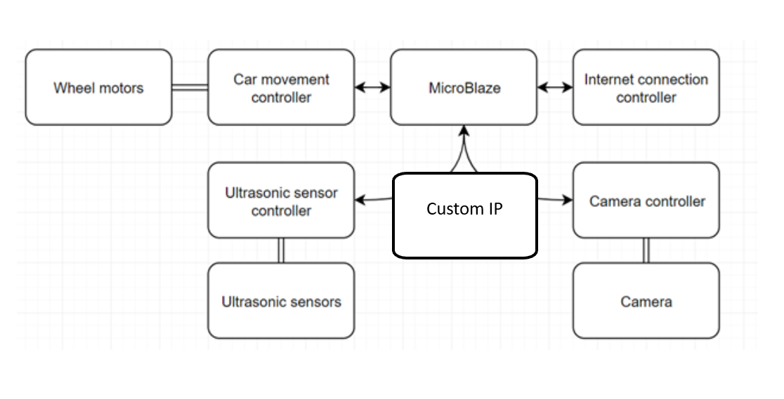
Project Overview(Planned)
Pmod DHB1
Pmod WiFi
Pmod Maxsonar
Pmod Camera

Slide 6
Project Overview(Final)
Pmod DHB1
Software IP
Pmod WiFi
Hardware IP
Pmod Maxsonar
Pmod Camera

Slide 7
Challenges and Problems
Discrepancies of our model car and a real car
The focus of the camera needs to be adjusted manually and very loose
Lego kit is not compatible with the Nexys4 board
Nexys 4 board requires long USB cable
Battery box is not done but was optional anyways(don’t want to experiment and ruin the board)

Slide 8
Design Process
Incremental design.
Use available resources online and build on that
Milestones
Working independently and then put together

Slide 9
Roles
Cheng Lin He:
RC car control with Pmod DHB1
Wireless communication with Pmod WiFi
Help with auto parking algorithm
Rick Chen:
Pmod Camera Ultrasonic Configuration
Auto Parking algorithm
Jing Xie:
Image processing algorithm - line detection
Auto Parking algorithm

Slide 10
Learning from this course
Team work on larger scale hardware design
Experience with Vivado design suite - a great tool for hardware design, debugging
Layout design, custom IP and SDK experience
Learned about test bench

Slide 11
Thank you for listening

